Slide 1

School of E&TC Engineering (SEE)
TY-BTech Major Project (SEM-VI)
Project – II (2307391)
Skin Disease Detection Using Deep Learning
Shinde Vaishnavi [202402060016]
Kalaskar Shreya [202402060006]
Yadav Pushkar [202402060017]
Aayush Katamkar [202402060015]
Supervised by
Prof. Vinaya S. Tapkir

Slide 2
Index
Introduction
Motivation
Problem Statement
Objectives
Literature Survey
Proposed method
Deployment result
Conclusion

Slide 3
Introduction
Skin diseases affect the skin and may cause rashes, inflammation, itching, or visible changes.
Causes can be genetic or related to lifestyle and environmental factors.
Treatments include medications, ointments, creams, and lifestyle modifications.
Common skin diseases: acne, alopecia areata, eczema (atopic dermatitis), and psoriasis.
Diagnostic tests include skin biopsy, culture tests, patch testing, and Wood’s lamp (UV) examination.

Slide 4
Motivation
Skin diseases can be highly contagious, as seen in the 2022 lumpy skin disease outbreak in India that killed over 97,000 cattle.
A large gap exists between dermatologists and patients due to lack of awareness about disease types, symptoms, and stages.
India has reported 32 mpox (monkeypox) cases since WHO’s 2022 emergency declaration; globally, over 103,000 cases and 229 deaths have occurred.
Accurate diagnosis of skin diseases is often difficult and costly.
Automatic computer-aided systems using machine learning enable faster and more accurate skin disease classification.

Slide 5
hhbh
Problem Statment
Skin diseases are conditions that affect your skin which may cause rashes, inflammation, itchiness or other skin changes which can lead to major discomfort and pain. Generally, many tests like blood test, Patch test, Diascopy, Biopsy, Dermoscopy etc. are used to test skin diseases.
These tests are time consuming which can lead to complications in patient’s health because of delay in diagnosis and treatment.
To overcome this problem, Development of Deep learning based classification system can be helpful to detect disease earlier improving diagnostic accuracy and reducing the workload for healthcare professionals.

Slide 6
OBJECTIVE
To pre-process skin disease Image datasets collected from Kaggle.
To apply different classical DL model to compare their accuracy.
To develop an advanced machine learning model for accurate and efficient classification of skin diseases.
To provide User-friendly API as a seamless and accessible interface for users to upload skin images and receive accurate disease predictions.

Slide 7
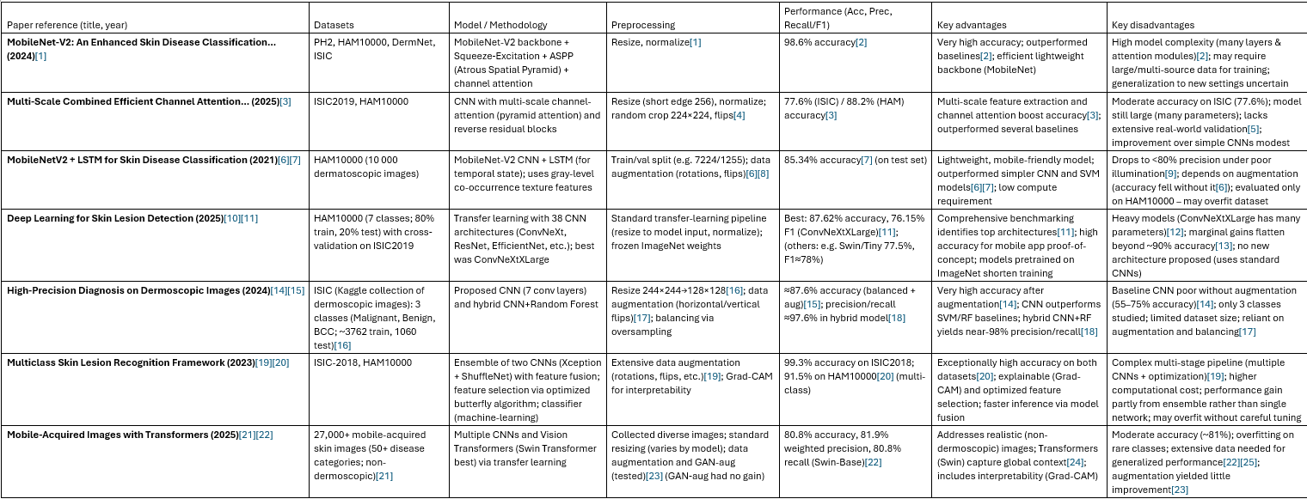
Literature Survey

Slide 8
Datasets used
Derm Net Dataset –
The dataset used in this project consists of approximately 16,000 dermatological images collected from various sources. It is designed for multi-class skin disease classification using deep learning techniques.
The dataset includes both diseased and normal skin images, enabling the model to distinguish between healthy and affected conditions.
The dataset contains 23 classes representing different skin conditions:
Dataset Characteristics
Total Images: ~16,000
Number of Classes: 23
Image Type: RGB images
Problem Type: Multi-class classification

Slide 9
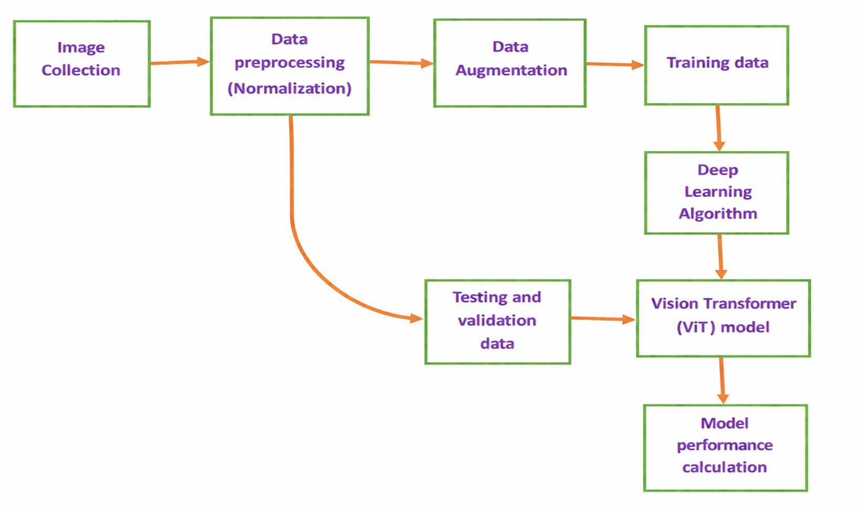
Proposed Method for skin Diseases Classification
Proposed Method for using Transformer model

Slide 10
Proposed Method for skin Diseases Classification
Proposed Method using Transformer model
Data Preprocessing:
Data preprocessing ensures that raw skin images are transformed into a format suitable for model training.
Resizing: All images are resized (e.g., 224×224) to maintain uniform input dimensions .
Normalization: Pixel values are scaled (0–1 or mean-std normalization) to stabilize training .
Label Encoding: Class labels are converted into numerical format .
Data Augmentation: Techniques like rotation, flipping, and zooming are applied to increase dataset diversity.
2. Model Architecture (Vision Transformer - ViT)
Core Components:
Patch Creation: Image is divided into fixed-size patches
Patch Embedding: Each patch is flattened and converted into a vector
Positional Encoding: Adds spatial information to patches
Transformer Encoder:
Multi-head self-attention
Feed-forward neural network
Classification Head: Fully connected layer + Softmax for final prediction

Slide 11
Proposed Method using Transformer model
3. Training Process
The model learns patterns from training data through iterative optimization.
Steps:
Input images are passed through the ViT model.
Predictions are generated
Calculates error
Updates model weights

Slide 12
Comparision of models
Parameter | MSID (EfficientNet Model) | DERMNET (EfficientNet model ) | ViT Model (Transformer)
Dataset Used | Small dataset (MSID) | Large DermNet (~19,000 images) | Medium dataset (~16,000 images)
No. of Classes | 4 | 23 | 23
Model Used | EfficientNet (CNN + Transfer Learning) | EfficientNet (CNN + Transfer Learning) | Vision Transformer (ViT)
Model Complexity | Low | high | High
Data Complexity | Low (distinct classes) | High | High
Accuracy | High (87%) | Moderate (~40–42%) | Higher (70%)
Training Time | Fast | Moderate | Slow (heavy computation)
Overfitting Risk | High (small data) | low (class imbalance) | Low–Medium
Problem: | overfit due to small dataset | Class imbalance | Longer training time
Confusion Between Classes | Low | High | Lower than CNN

Slide 13
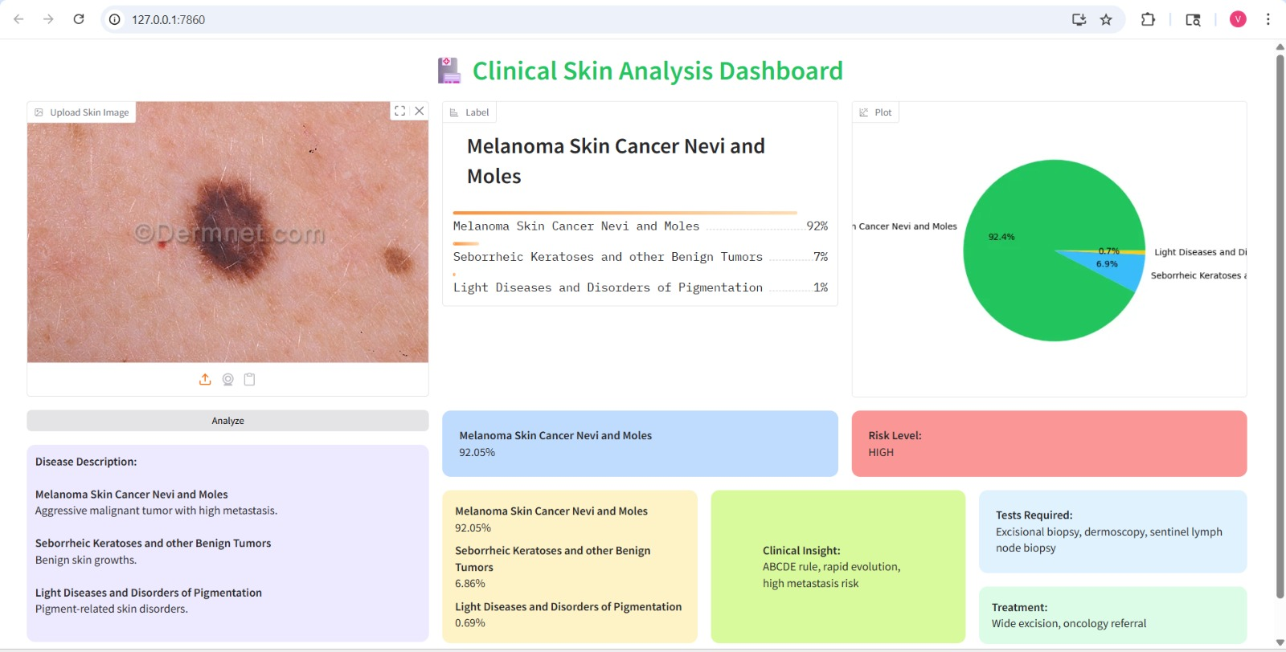
DEPLOYMENT OF MODEL

Slide 14
Conclusion
This project focused on developing a skin disease classification system using transfer learning models such as EfficientNet and Vision Transformer (ViT). The results show that EfficientNet performs well on simpler datasets with fewer classes, achieving higher accuracy due to lower complexity, but its performance decreases when applied to more complex datasets with many similar classes. In contrast, the Vision Transformer model demonstrates better performance on complex data by capturing global relationships within images using self-attention mechanisms. Overall, the study highlights that model performance depends not only on the architecture but also on dataset size, diversity, and complexity, and that transformer-based models have strong potential for real-world medical image classification tasks.

Slide 15
References
1) V. B. Kumar, S. S. Kumar and V. Saboo, "Dermatological disease detection using image processing and machine learning", 2016 Third International Conference on Artificial Intelligence and Pattern Recognition (AIPR), pp. 1-6, 2016. 10.1109/ICAIPR.2016.7585217
2)Ali, K.; Shaikh, Z.A.; Khan, A.A.; Laghari, A.A. Multiclass skin cancer classification using
EfficientNets—A first step towards preventing skin cancer. Neurosci. Inform. 2022, 2, 100034.
3) Reddy, D.A.; Roy, S.; Kumar, S.; Tripathi, R. A Scheme for Effective Skin Disease Detection using Optimized Region Growing Segmentation and Autoencoder based Classification. Procedia Comput. Sci. 2023, 218, 274–282
4)An Intelligent Computer-Aided Scheme for Classifying Multiple Skin Lesions by Nazia Hameed, Fozia Hameed, Antesar Shabut, Sehresh Khan,Silvia Cirstea,Alamgir Hossain Published on 28 August 2019, https://doi.org/10.3390/computers8030062
5) Shetty, B.; Fernandes, R.; Rodrigues, A.P.; Chengoden, R.; Bhattacharya, S.; Lakshmanna, K. Skin lesion classification of dermoscopic images using machine learning and convolutional neural network. Sci. Rep. 2022, 12, 18134. ,36307467
6) Targeted Ensemble Machine Classification Approach for Supporting IoT Enabled Skin Disease
Detection by Hong Qing Yu And Stephan Reiff-Marganiec.
7) Hsu, B.W.Y.; Tseng, V.S. Hierarchy-aware contrastive learning with late fusion for skin lesion classification. Comput. Methods Programs Biomed. 2022, 216, 106666. https://doi.org/10.1016/j.cmpb.2022.106666

Slide 16
References
[1] Nirupama and Virupakshappa (2024), “MobileNet-V2: An Enhanced Skin Disease Classification by Attention and Multi-Scale Features,” Journal of Imaging Informatics in Medicine, vol. 38, pp. 1734–1754. DOI:10.1007/s10278-024-01271-y[1][2]. [2] H. Liu et al. (2025), “A skin disease classification model based on multi-scale combined efficient channel attention module,” Scientific Reports, vol. 15, 2025. DOI:10.1038/s41598-025-00000-0[3][4]. [3] P.N. Srinivasu et al. (2021), “Classification of Skin Disease Using Deep Learning Neural Networks with MobileNet V2 and LSTM,” Sensors, vol. 21, no. 8, 2852 (2021). DOI:10.3390/s21082852[6][7]. [4] J. Vieira, F. Mendonça, and F. Morgado-Dias (2025), “Deep Learning Approaches for Skin Lesion Detection,” Electronics, vol. 14, 2785 (2025). DOI:10.3390/electronics14142785[10][11]. [5] S.G. Malik et al. (2024), “High-Precision Skin Disease Diagnosis through Deep Learning on Dermoscopic Images,” Bioengineering 11(9):867. DOI:10.3390/bioengineering11090867[14][15]. [6] N. Ahmad et al. (2023), “A novel framework of multiclass skin lesion recognition from dermoscopic images using deep learning and explainable AI,” Frontiers in Oncology, vol. 13, 1151257 (2023). DOI:10.3389/fonc.2023.1151257[19][20]. [7] A. Newaz et al. (2025), “Toward Accessible Dermatology: Skin Lesion Classification Using Deep Learning Models on Mobile-Acquired Images,” arXiv preprint 2509.04800 (2025). [Online]. Available: https://arxiv.org/abs/2509.04800[21][22].

Slide 17
Thank You!!

